Slide 1
Customer Segmentation Using RFM Analysis in E-Commerce

Slide 2
Problem Statement and Objective
Problem Statement:
E-commerce companies generate large volumes of transactional data but often struggle to convert it into actionable customer insights. Without proper segmentation, businesses find it difficult to identify high-value customers, reduce churn, and optimize marketing strategies.
RFM analysis helps analyse customer purchasing behaviour and enables data-driven marketing decisions.
Project Objectives:
• Apply the RFM (Recency, Frequency, Monetary) model to segment customers. • Identify high-value customers and at-risk segments. • Analyse purchasing behaviour patterns. • Provide insights through interactive dashboards and visualizations

Slide 3
Dataset Overview
Source: Online Retail Dataset
Dataset Type: Transactional E-commerce sales data
Records: 541,909 transactions
Features: 8 variables
Time Period: Dec 2010 – Dec 2011
Key variables
InvoiveNo : Unique transaction ID
Stockcode : Unique product identifier
Description: Product description
Quantity : Number of items purchased
InvoiceDate: Purchase date
UnitPrice : Price per product
CustomerID: Unique customer identifier
Country : Customer location

Slide 4
Data Cleaning and Preparation
Removed missing values
Removed duplicate transactions
Filtered cancelled orders (InvoiceNo starting with 'C’)
Removed non-product stock codes
Ensured dataset contains valid completed purchases only

Slide 5
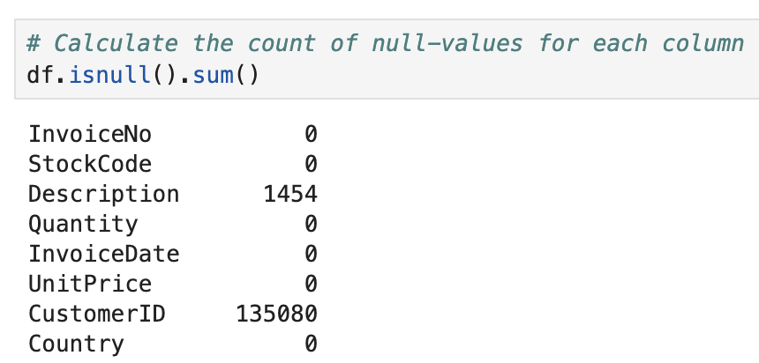
Data Cleaning and Preparation
1. Handling Missing values:
The percentage of missing values in the CustomerID column is 24.93%.
Since the analysis will revolve around investigating customers and clustering them into categories, the missing values in the CustomerIDs were removed.

Slide 6
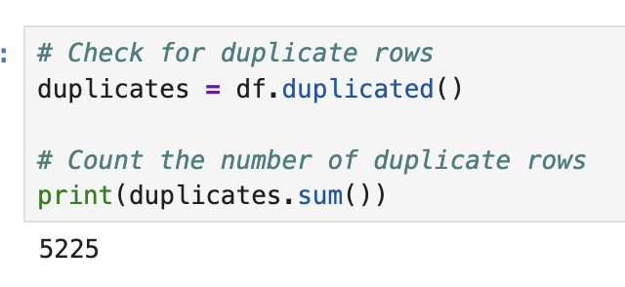
Data Cleaning and Preparation
2. Removed duplicate transactions:
The number of duplicate rows in the dataset is 5525.
These rows were removed from the dataset.

Slide 7
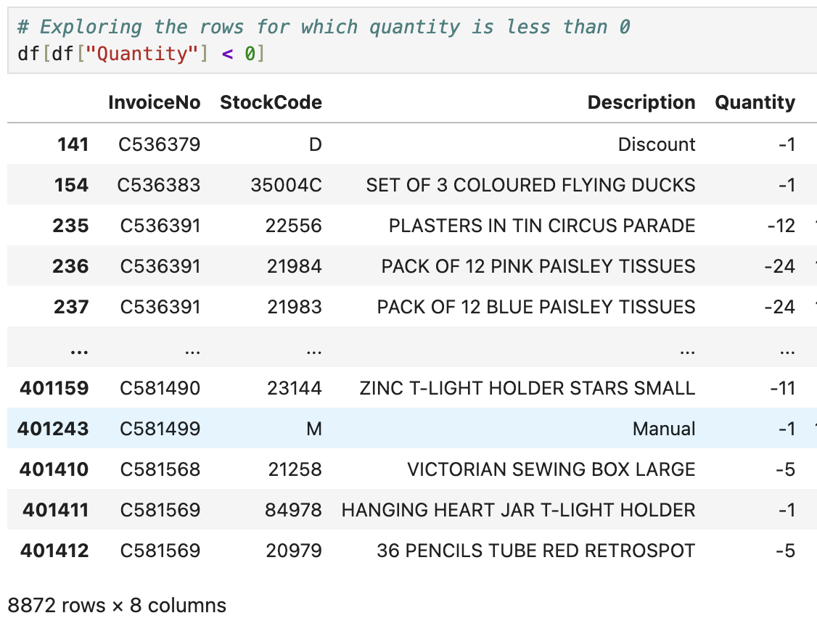
Data Cleaning and Preparation
3.Removed Cancelled orders:
There are 8872 rows for which the quantity is negative which can be either due to data-entry errors or return orders or cancelled orders.
If we look at the InvoiceNo for all these cases, they start with the letter ‘C’ which indicates they are cancelled orders. Thus these rows were removed from the dataset

Slide 8
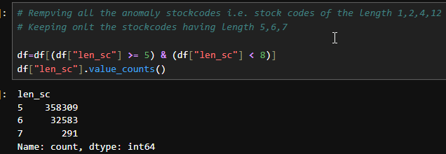
Data Cleaning and Preparation
4. Removing Non-Product Stock-codes:
Stock Codes | Description
POST | Postage Charges
C2 | Carriage Cost
M | Manual adjustment
DOT | Dotcom Postage Charges
BANK CHARGES | Bank Charges
There are certain StockCodes which do not belong to any products. All the rows containing such StockCodes were removed.

Slide 9
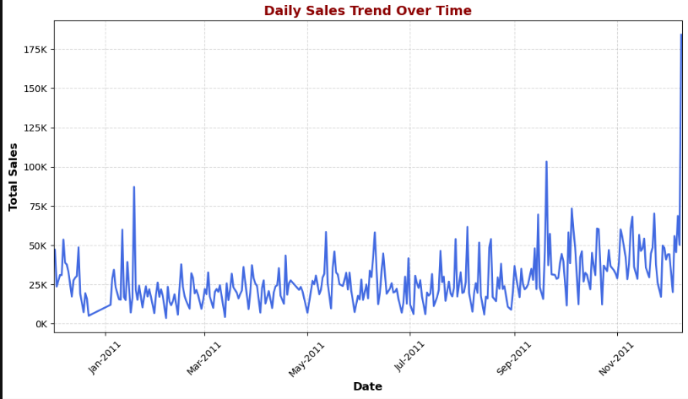

Slide 10
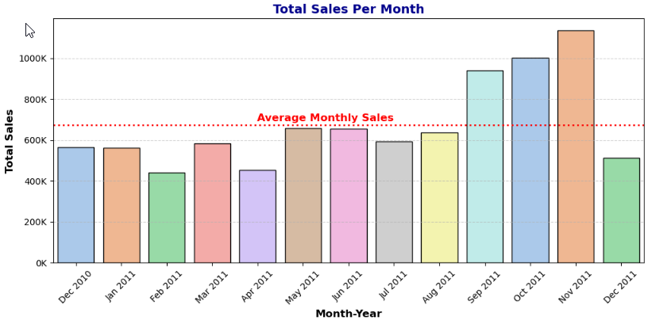
Significant increase in sales during September, October, and November 2011.
November 2011 recorded the highest sales (~1.13M).
Average monthly sales: 6,72,094.

Slide 11
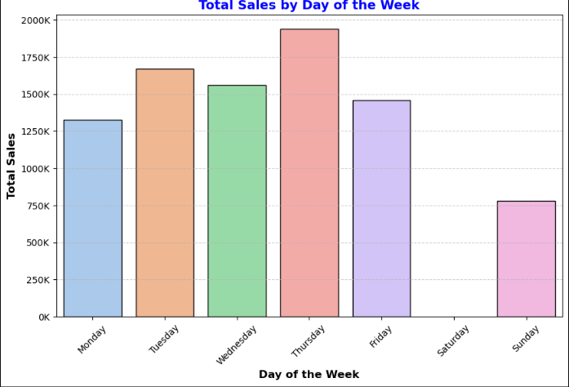
Thursday recorded the highest sales (~22.2%).
No transactions were recorded on Saturday, indicating the business likely does not operate that day.
Sunday sales are lower compared to weekdays.

Slide 12
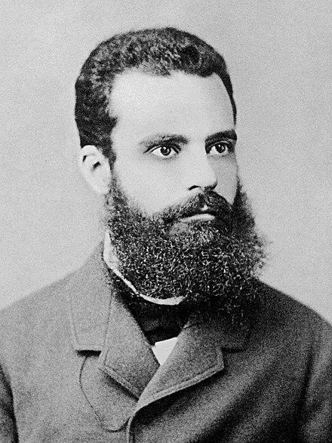
Pareto Principle
The Pareto Principle states that a small percentage of customers generate the majority of revenue.
In analytics, this is commonly known as the 80/20 rule, where approximately 20% of customers contribute around 80% of total sales.

Slide 13
Customer Contribution to Revenue
Key Statistics:
Total Customers: 4,335
Total Products: 3,659
Pareto Analysis Result:
26% of customers contribute to 80% of total revenue
Insight:
A small group of high-value customers drives the majority of sales, highlighting the importance of customer segmentation and retention strategies.

Slide 14
Product Contribution Analysis
Revenue Contribution:
21% of products generate 80% of total revenue
Sales Volume Contribution:
23% of products generate 80% of total sales volume
Insight:
A limited number of products contribute most of the revenue and sales volume.
This suggests businesses should focus on:
Promoting top-performing products
Optimizing inventory management

Slide 15
RFM Analysis and Customer Segmentation
What is RFM?
RFM is a customer segmentation technique used to analyse purchasing behaviour based on three metrics.
Recency (R) : Days since the last purchase
Frequency (F) : Number of purchases made
Monetary (M) : Total amount spent by the customer
Customers are segmented into five equal buckets based on Recency, Frequency, and Monetary values. Each customer is ranked for each metric, assigned a score from 1 to 5, and their scores are summed to derive an overall RFM score for analysis.

Slide 16
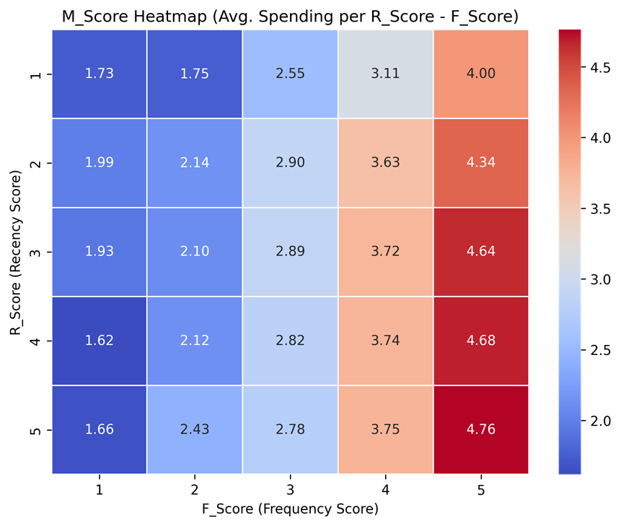
Heat Map Based on RFM Scores

Slide 17
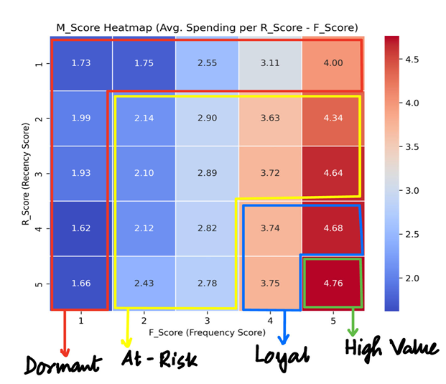
RFM Analysis and Customer Segmentation
Based on this RFM Score Analysis, we have four customer segments:
High Value:Customers who purchase recently, frequently, and spend the most. They are the most valuable customers for the business.
Loyal:Customers who buy regularly but may not spend as much as high-value customers
At-Risk:Customers who used to purchase before but have not bought recently and may stop buying.
Dormant:Customers who have not purchased for a long time and rarely buy.

Slide 18
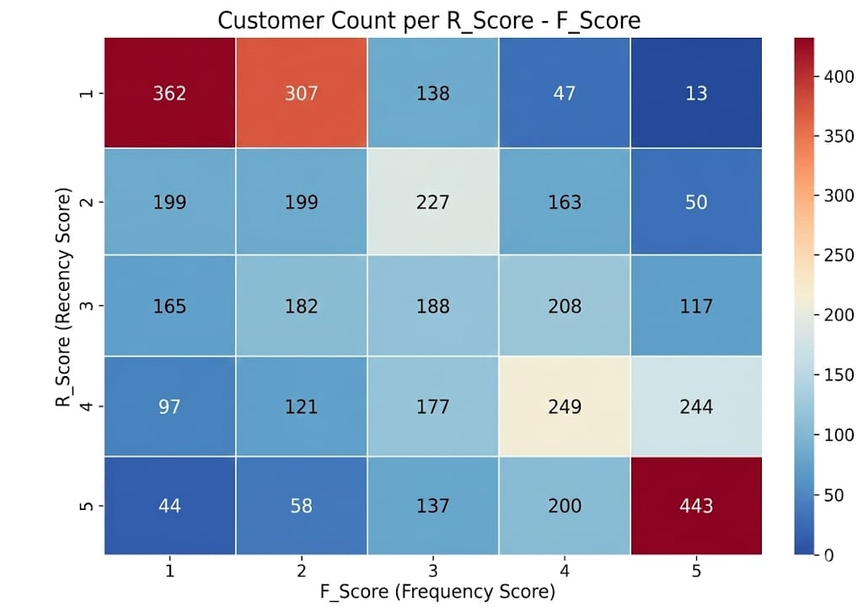
Heat Map Based on RFM(Customer Count per R-Score – F-Score)
The highest customer count appears in R=1, F=1 (362 customers), indicating many customers have not purchased recently and buy infrequently, showing potential inactivity.
A strong cluster of customers is visible in R=5, F=5 (443 customers), representing highly engaged and valuable customers who purchase frequently and recently.
Several customers fall into R=4–5 and F=4–5 ranges, suggesting a group of loyal and active customers with strong engagement.
Many customers are concentrated in low recency and low frequency regions, indicating opportunities for re-engagement and retention campaigns

Slide 19
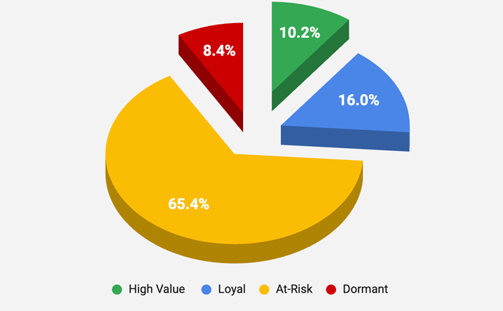
Customer Segmentation Distribution
Insights:
At-Risk – 2837 customers (65.4%) Largest segment; many customers have not purchased recently.
Loyal – 693 customers (16.0%) Customers who purchase regularly and maintain engagement.
High Value – 443 customers (10.2%) Highly valuable customers who purchase frequently and recently.
Dormant – 362 customers (8.4%) Inactive customers who have not purchased for a long time.

Slide 20
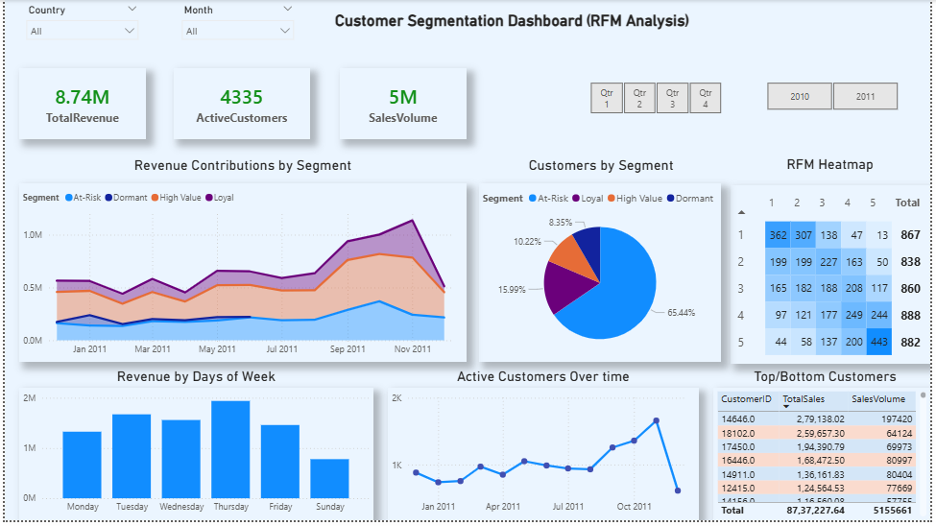
Dashboard

Slide 21
Recommendations Based on Segments
High Value Customers:
Characteristics: Highly engaged customers with the highest spending.
Behaviour: Recent purchases, high purchase frequency, and high spending.
Strategy: Offer loyalty rewards, exclusive deals, and early access to products
Loyal Customers:
Characteristics: Regular customers who purchase consistently.
Behaviour: Moderate recency, good purchase frequency, and steady spending.
Strategy: Provide personalized recommendations and upsell/cross-sell offers.

Slide 22
Recommendations Based on Segments
At-Risk Customers:
Characteristics: Customers who were active before but are becoming less engaged.
Behaviour: Longer time since last purchase and lower purchase frequency.
Strategy: Send personalized emails, discounts, and re-engagement campaigns.
Dormant Customers:
Characteristics: Inactive customers with a high risk of churn.
Behaviour: Long time since last purchase, low frequency, and low spending.
Strategy: Run win-back campaigns, offer special discounts, and collect feedback.

